Slide 1
Flow H2O
“Saving water, one drop at a time.”
Jefferson Yu, Brian Xu, Joshua Bello, Ankit Patel, Sannidhya Desai

Slide 2
Water Crisis
70% of the world is covered by water
Only 2.5% of our water is fresh
Only 1% of this freshwater is easily accessible
There are 7.4 billion people on this earth
Fresh Water Is Running Out!!
Cities are projected to run out of water by 2024.

Slide 3
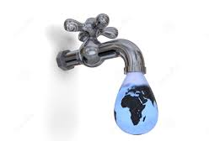
Problem
People waste BILLIONS of gallons of water on a daily basis without even noticing it, causing detrimental NEGATIVE CONSEQUENCES in:
The Environment
The Economy
Our Society

Slide 4
Per Capita Usage Statistics
The average American daily water usage:
101.5 gallons per capita
How much water a person needs daily:
80 gallons per capita
VS

Slide 5
More than 6.5 BILLION gallons
2.5 TRILLION gallons wasted ANNUALLY
Average water WASTED daily in America

Slide 6
Economic and Societal Effect
The average household spends about $.007 per gallon of water
Each American family wastes approximately $230 a year

Slide 7

Environmental Effect
Increase in water scarcity = severe droughts
Less freshwater for aquatic species
Water takes a large amount of energy to filter and clean. Wasting water is wasting energy!!!

Slide 8
ROOT CAUSE:
Ignorance

Slide 9
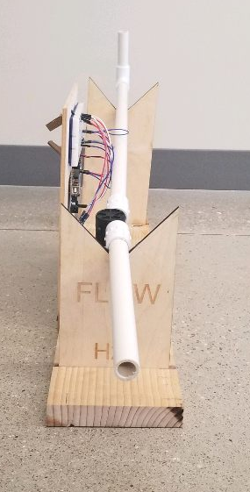
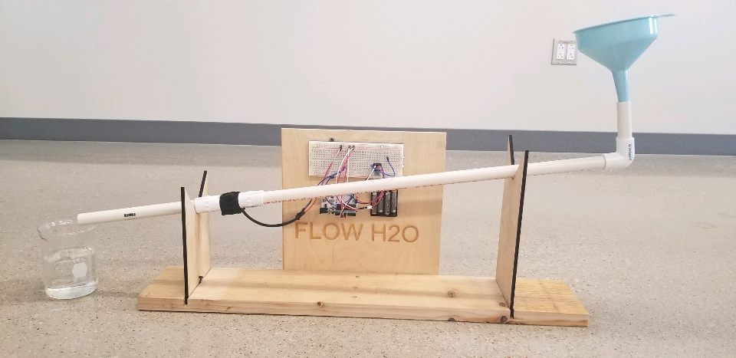
Solution: Flow H20

Slide 10
Demonstration

Slide 11
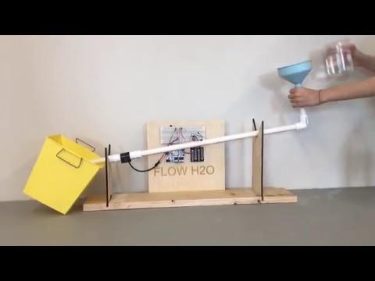


Slide 12
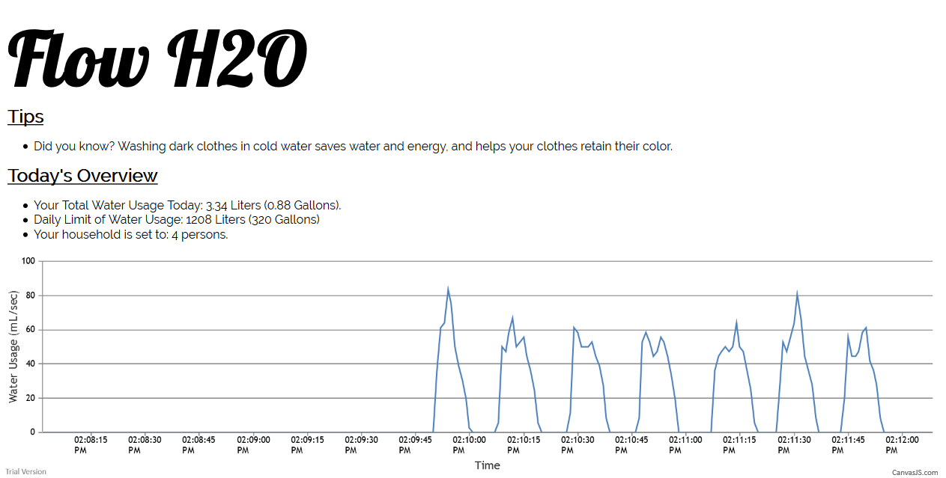

Slide 13
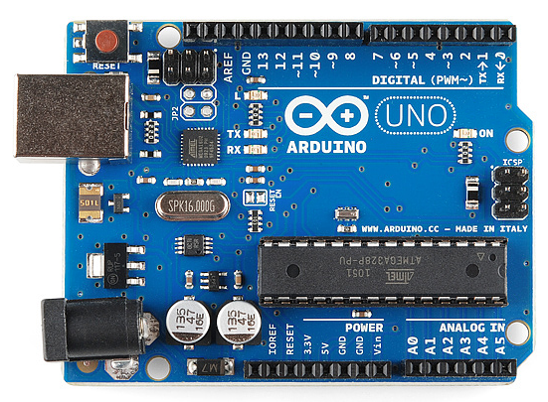


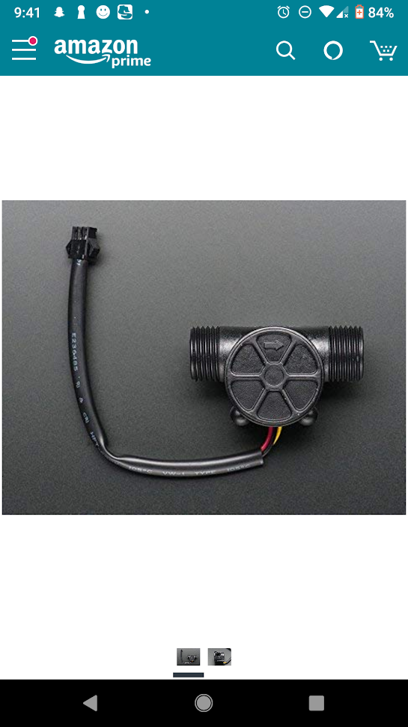


How it works
Arduino
Board
Bluetooth Connection
Volumetric Water
Flow Sensor
Txt File
HTML 5 Webpage
Javascript
Reader

Slide 14
How it solves
Makes people AWARE.
Gives people an initiative to save water, through notification system
People won’t waste water because wasting water is wasting money.

Slide 15
Community benefits
REPLENISH dried lakes, reservoirs, and rivers.
CONSERVE water for droughts and emergencies.
SAVE money on running water.
CONTRIBUTE to growing water crisis.

Slide 16
Impact
If every person can save just 6 gallons a day
700 billion gallons of water saved per year in America

Slide 17
Product costs
$15-20 to manufacture each unit
Other costs include:
Starting manufacturing prices ($2,010 for $10,000 worth of Flow H2O products)
Licensing fees
Shipping cost ($2 - $3)

Slide 18
Revenue Streams
75% Margins (With $15 cost)
Profitable in 1-2 years
Selling for $35 per unit
150% Margins (With $20 cost)
Profitable in < 1 year
Selling for $50 per unit

Slide 19
Consumer Base
Potential consumer base size of 126.22 MILLION in America
Flow H2O attracts:
The 17.9 MILLION smart-home owners in America
Companies who want to keep track of water usage
Eco-friendly citizens of America

Slide 20
Flow h20’s value
To Customers:
Serves as a way to view and conserve water usage
Customizable, user-friendly, and encourages conservation of water
To Investors/Businesses:
There is little competition in the market Flow H2O is in.
Has general purpose use which means it can be implemented in most consumer’s houses.

Slide 21
Water Available for emergencies

Slide 22
Maintain a green world

Slide 23
Refill reservoirs

Slide 24
700 billion gallons of water saved

Slide 25
28 trillion dollars preserved

Slide 26
All With Flow H2O

Slide 27
Thank You For Your Time!

